Slide 1
Data Mining
Introduction
Data mining Architecture
Data Mining Process
Knowledge Discovery from Databases (KDD)
Some Mining Methods

Slide 2
What Is Data Mining?

Slide 3
What Is Data Mining?
Data mining refers to extracting or mining knowledge from large amounts of data.
Mining of gold from rocks or sand
Knowledge mining from data, knowledge extraction, data/pattern analysis, data archeology, and data dredging.
Knowledge Discovery from data, or KDD

Slide 4
What Is Data Mining?
It is the computational process of discovering patterns in large data sets involving methods at the intersection of artificial intelligence, machine learning, statistics, and database systems.
The overall goal of the data mining process is to extract information from a data set and transform it into an understandable structure for further use.
Notes:
AI-the theory and development of computer systems able to perform tasks normally requiring human intelligence, such as visual perception, speech recognition, decision-making, and translation between languages.
Artificial intelligence (AI) is the ability of a computer or a robot controlled by a computer to do tasks that are usually done by humans because they require human intelligence and discernment.
ML-The use and development of computer systems that are able to learn and adapt without following explicit instructions, by using algorithms and statistical models to analyse and draw inferences from patterns in data. It's a subset of artificial intelligence (AI), which focuses on using statistical techniques to build intelligent computer systems to learn from available databases.
Statistics - the practice or science of collecting and analysing numerical data in large quantities, especially for the purpose of inferring proportions in a whole from those in a representative sample.

Slide 5
The key Properties of Data Mining
Automatic discovery of patterns
Prediction of likely outcomes
Creation of actionable information
Focus on large datasets and databases

Slide 6
The Scope of Data Mining
Data mining derives its name from the similarities between searching for valuable business information in a large database — for example, finding linked products in gigabytes of store scanner data — and mining a mountain for a deposit of valuable ore.
Both processes require either sifting through an immense amount of material, or intelligently probing it to find exactly where the value resides.

Slide 7
The Scope of Data Mining..
Given databases of sufficient size and quality, data mining technology can generate new business opportunities by providing these capabilities:
Automated prediction of trends and behaviors - Data mining automates the process of finding predictive information in large databases, e.g. Targeted marketing, forecasting bankruptcy and other forms of default, etc.
Automated discovery of previously unknown patterns - Data mining tools sweep through databases and identify previously hidden patterns in one step, e.g. Market basket analysis, Fraud detection, Data keying errors detection

Slide 8
Tasks of Data Mining
Data mining involves six common classes of tasks:
Anomaly detection (Outlier/change/deviation detection)
The identification of unusual data records, that might be interesting or data errors that require further investigation.
Association rule learning (Dependency modelling)
Searches for relationships between variables.
For example a supermarket might gather data on customer purchasing habits. Using association rule learning, the supermarket can determine which products are frequently bought together and use this information for marketing purposes. This is also referred to as market basket analysis.

Slide 9
Tasks of Data Mining
Clustering
The task of discovering groups and structures in the data that are in some way or another "similar", without using known structures in the data.
Classification
The task of generalizing known structure to apply to new data. For example, an e-mail program might attempt to classify an e-mail as "legitimate" or as "spam".
Regression
Attempts to find a function which models the data with the least error.
Summarization
Providing a more compact representation of the data set, including visualization and report generation.

Slide 10
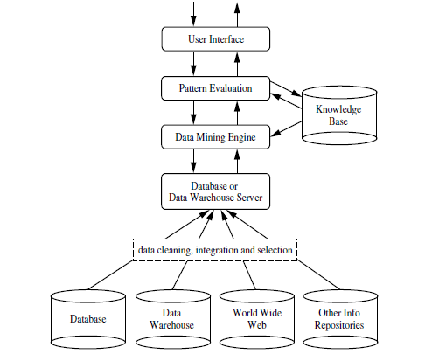
Architecture of Data Mining

Slide 11
Architecture of Data Mining..
Knowledge Base: This is the domain knowledge that is used to guide the search or evaluate the interestingness of resulting patterns.
Such knowledge can include concept hierarchies used to organize attributes or attribute values into different levels of abstraction.
Knowledge such as user beliefs, which can be used to assess a pattern’s interestingness based on its unexpectedness, may also be included.
Other examples of domain knowledge are additional interestingness constraints or thresholds, and metadata (e.g., describing data from multiple heterogeneous sources).
Data Mining Engine: - This is essential to the data mining system and ideally consists of a set of functional modules for tasks such as characterization, association and correlation analysis, classification, prediction, cluster analysis, outlier analysis and evolution analysis.

Slide 12
Architecture of Data Mining..
Pattern Evaluation Module:
This component typically employs interestingness measures.
Interacts with the data mining modules so as to focus the search toward interesting patterns.
May use interestingness thresholds to filter out discovered patterns.
Alternatively, the pattern evaluation module may be integrated with the mining module, depending on the implementation of the data mining method used.
For efficient data mining, it is highly recommended to push the evaluation of pattern interestingness as deep as possible into the mining process so as to confine the search to only the interesting patterns.

Slide 13
Architecture of Data Mining..
User interface:
This module communicates between users and the data mining system, allowing the user to interact with the system by specifying a data mining query or task, providing information to help focus the search, and performing exploratory data mining based on the intermediate data mining results.
Allows the user to browse database and data warehouse schemas or data structures, evaluate mined patterns, and visualize the patterns in different forms.

Slide 14
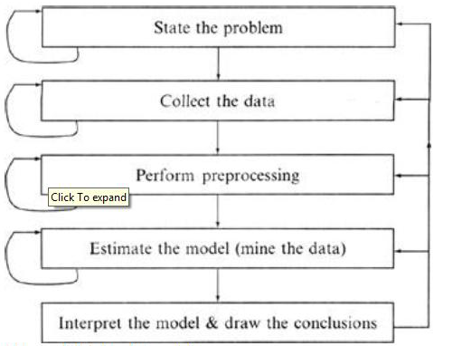
Data Mining Process

Slide 15
Data Mining Process..
Data Mining is a process of discovering various models, summaries, and derived values from a given collection of data.
The general experimental procedure adapted to data-mining problems involves the following steps:
State the problem and formulate the hypothesis:
-Most data-based modeling studies are performed in a particular application domain.
-Domain-specific knowledge and experience are usually necessary to come up with a meaningful problem statement

Slide 16
Data Mining Process..
State the problem and formulate the hypothesis ...
A modeler specifies a set of variables for the unknown dependency and, if possible, a general form of this dependency as an initial hypothesis.
There may be several hypotheses formulated for a single problem at this stage.
The first step requires the combined expertise of an application domain and a data-mining modeler.
In practice, it usually means a close interaction between the data-mining expert and the application expert.
In successful data-mining applications, this cooperation does not stop in the initial phase; it continues during the entire data-mining process.

Slide 17
Data Mining Process..
2. Collect the data
Concerned with how the data are generated and collected.
In general, there are two distinct possibilities.
The first is when the data-generation process is under the control of an expert (modeler): this approach is known as a designed experiment.
The second possibility is when the expert cannot influence the data- generation process: this is known as the observational approach.
An observational setting, namely, random data generation, is assumed in most data-mining applications.
Typically, the sampling distribution is completely unknown after data are collected, or it is partially and implicitly given in the data-collection procedure.

Slide 18
Data Mining Process
Collect the data ...
It is very important, however, to understand how data collection affects its theoretical distribution, since such a priori knowledge can be very useful for modeling and, later, for the final interpretation of results.
Also, it is important to make sure that the data used for estimating a model and the data used later for testing and applying a model come from the same, unknown, sampling distribution.
If this is not the case, the estimated model cannot be successfully used in a final application of the results.

Slide 19
Data Mining Process..
3. Pre-processing the data
In the observational setting, data are usually "collected" from the existing databases, data warehouses, and data marts.
Data pre-processing usually includes at least two common tasks:
Outlier detection
Scaling, encoding, and selecting features

Slide 20
Data Mining Process..
Outlier detection (and removal)
Outliers are unusual data values that are not consistent with most observations.
Commonly, outliers result from measurement errors, coding and recording errors, and, sometimes, are natural, abnormal values.
Such non-representative samples can seriously affect the model produced later.
There are two strategies for dealing with outliers:
(i) Detect and eventually remove outliers as part of the preprocessing phase, or
(ii) Develop robust modeling methods that are insensitive to outliers.

Slide 21
Data Mining Process..
Scaling, encoding, and selecting features
Data pre-processing includes several steps such as variable scaling and different types of encoding.
For example, one feature with the range [0, 1] and the other with the range [−100, 1000] will not have the same weights in the applied technique; they will also influence the final data-mining results differently. Therefore, it is recommended to scale them and bring both features to the same weight for further analysis.
Also, application-specific encoding methods usually achieve dimensionality reduction by providing a smaller number of informative features for subsequent data modeling.
Notes:
Rescaling (min-max normalization) For example, suppose that we have the students' weight data, and the students' weights span [160 pounds, 200 pounds]. To rescale this data, we first subtract 160 from each student's weight and divide the result by 40 (the difference between the maximum and minimum weights).

Slide 22
Data Mining Process..
Scaling, encoding, and selecting features
Data pre-processing steps should not be considered completely independent from other data-mining phases.
In every iteration of the data-mining process, all activities, together, could define new and improved data sets for subsequent iterations.
Generally, a good pre-processing method provides an optimal representation for a data-mining technique by incorporating a priori knowledge in the form of application-specific scaling and encoding.

Slide 23
Data Mining Process..
4. Estimate the model
The selection and implementation of the appropriate data-mining technique is the main task in this phase.
This process is not straightforward; usually, in practice, the implementation is based on several models, and selecting the best one is an additional task.
The basic principles of learning and discovery from data and analysis of specific techniques that are applied to perform a successful learning process from data and developing an appropriate model are beyond this course scope.

Slide 24
Data Mining Process
5. Interpret the model and draw conclusions
In most cases, data-mining models should help in decision making.
Hence, such models need to be interpretable in order to be useful because humans are not likely to base their decisions on complex "black-box" models.
A user does not want hundreds of pages of numeric results. He does not understand them; he cannot summarize, interpret, and use them for successful decision making.
Note that the goals of accuracy of the model and accuracy of its interpretation are somewhat contradictory.
Usually, simple models are more interpretable, but they are also less accurate.
Modern data-mining methods are expected to yield highly accurate results using high dimensional models.
The problem of interpreting these models, also very important, is considered a separate task, with specific techniques to validate the results.

Slide 25
Knowledge Discovery in Databases(KDD)
Some people treat data mining same as Knowledge discovery while some people view data mining as an essential step in the process of knowledge discovery.
Here is the list of steps involved in knowledge discovery process:
Data Cleaning: In this step the noise and inconsistent data is removed.
Data Integration: In this step multiple data sources are combined.
Data Selection: In this step data relevant to the analysis task are retrieved from the database.
Data Transformation: In this step data are transformed or consolidated into forms appropriate for mining by performing summary or aggregation operations.
Data Mining: In this step intelligent methods are applied in order to extract data patterns.
Pattern Evaluation : In this step, data patterns are evaluated.
Knowledge Presentation: In this step, knowledge is represented.

Slide 26
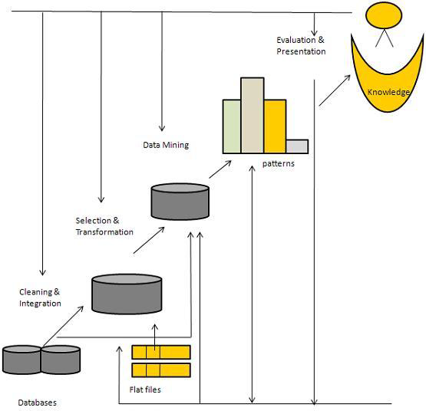
Architecture of KDD
Data mining: the core of knowledge discovery process.
Task-relevant Data
Data Warehouse

Slide 27
Steps of a KDD Process
Learning the application domain:
Relevant prior knowledge and goals of application
Creating a target data set:
Data selection, data cleaning and preprocessing
Data reduction and transformation:
Find useful features, dimensionality/variable reduction, invariant representation.

Slide 28
Steps of a KDD Process..
Choosing functions of data mining:
Summarization, classification, regression, association, clustering.
Choosing the mining algorithms
Data mining:
Search for patterns of interest
Pattern evaluation and knowledge presentation
Visualization, transformation, removing redundant patterns, etc.
Use of discovered knowledge

Slide 29
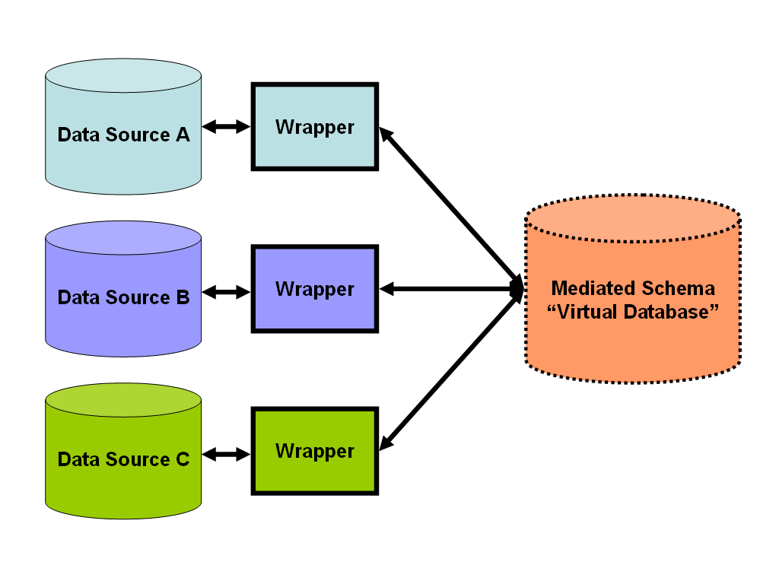
Data Preprocessing
Data Integration:
Combines data from multiple sources into a coherent data store, as in data warehousing.
The sources may include multiple databases, data cubes, or flat files.
The data integration systems are formally defined as triple <G,S,M> , where:
G: the global schema
S:Heterogeneous source of schemas
M: Mapping between the queries of source and global schema

Slide 30
Issues in Data integration
Schema integration and object matching:
How can the data analyst or the computer be sure that customer id in one database and customer number in another reference to the same attribute.
Redundancy:
An attribute (such as annual revenue, for instance) may be redundant if it can be derived from another attribute or set of attributes. Inconsistencies in attribute or dimension naming can also cause redundancies in the resulting data set.
Detection and resolution of data value conflicts:
For the same real-world entity, attribute values from different sources may differ.

Slide 31
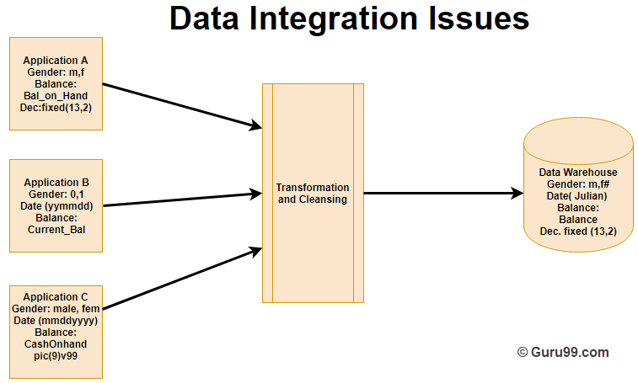
Notes:
Data integration means the establishment of a common unit of measure for all similar data from the dissimilar database
A data warehouse is developed by integrating data from varied sources like a mainframe, relational databases, flat files, etc. Moreover, it must keep consistent naming conventions, format, and coding.
This integration helps in effective analysis of data. Consistency in naming conventions, attribute measures, encoding structure etc. have to be ensured. Consider the following example:
In the above example, there are three different applications labeled A, B and C. Information stored in these applications are Gender, Date, and Balance. However, each application’s data is stored different way.
What PIC 9v99 means?
PICTURE 9v99 is a three position Numeric field with an implied or assumed decimal point after the first position; the v means an implied decimal point.

Slide 32
Data Transformation
In data transformation, the data are transformed or consolidated into forms appropriate for mining.
Data transformation can involve the following:
Smoothing, which works to remove noise from the data
Such techniques include binning, regression, and clustering.
Aggregation, where summary or aggregation operations are applied to the data.
For example, the daily sales data may be aggregated so as to compute monthly and annual total amounts
This step is typically used in constructing a data cube for analysis of the data at multiple granularities.
Generalization of the data, where low-level or ―primitive‖ (raw) data are replaced by higher-level concepts through the use of concept hierarchies.
For example, categorical attributes, like street, can be generalized to higher-level concepts, like city or country.

Slide 33
Data Transformation..
Normalization, where the attribute data are scaled so as to fall within a small specified range, such as -1:0 to 1:0, or 0:0 to 1:0.
Attribute construction (or feature construction), where new attributes are constructed and added from the given set of attributes to help the mining process.

Slide 34
Data Reduction
Data reduction techniques can be applied to obtain a reduced representation of the data set that is much smaller in volume, yet closely maintains the integrity of the original data.
That is, mining on the reduced data set should be more efficient yet produce the same (or almost the same) analytical results.
Strategies for data reduction include the following:
Data cube aggregation, where aggregation operations are applied to the data in the construction of a data cube.
Dimensionality reduction – attribute subset selection or encoding mechanisms are used to reduce the dataset size
Feature Selection – process of removing the irrelevant or redundant features.
Feature Extraction – e process of transforming data into features suitable for modeling
Notes:
encoding, involves putting thoughts, ideas, or information into a symbolic form.

Slide 35
Data Reduction ..
Numerosity reduction;
The data are replaced or estimated by alternative, smaller data representations
For example using parametric models (which need store only the model parameters instead of the actual data) or nonparametric methods such as clustering, sampling, and the use of histograms.
Discretization and concept hierarchy generation
Raw data values for attributes are replaced by ranges or higher conceptual levels.
Data discretization is a form of numerosity reduction that is very useful for the automatic generation of concept hierarchies.
Discretization and concept hierarchy generation are powerful tools for data mining, in that they allow the mining of data at multiple levels of abstraction.

Slide 36
Mining Methods

Slide 37
Association Rule Mining
Association rule mining is a popular and well researched method for discovering interesting relations between variables in large databases.
It is intended to identify strong rules discovered in databases using different measures of interestingness.
Based on the concept of strong rules – Rakesh Agrawal et al. introduced association rules.

Slide 38
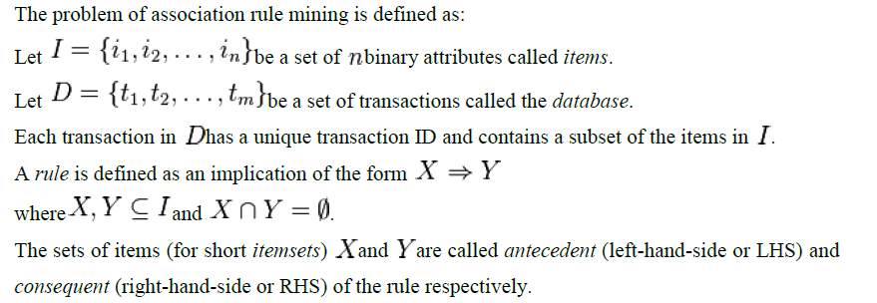
Association Rule Mining : Problem definition

Slide 39

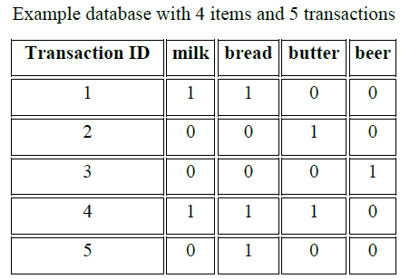

Association Rule Mining: Problem Definition
Let
as items in a supermarket
and given an instance of transactions database:
An example rule for the supermarket could be:
meaning that if butter and bread are bought, customers also buy milk.

Slide 40

Important concepts of Association Rule Mining
The support
of an itemset
Is defined as the proportion of transactions in the data set which contain the itemset
The confidence of a rule is defined:
Confidence can be interpreted as an estimate of the probability,
The probability of finding the RHS of the rule in transactions under the condition that these transactions also contain the LHS.
The lift of a rule is defined as
or the ratio of the observed support to that expected if X and Y were independent

Slide 41





Important concepts of Association Rule Mining
The conviction of a rule is defined as
interpreted as the ratio of the expected frequency that X occurs without Y (that is to say, the frequency that the rule makes an incorrect prediction) if X and Y were independent divided by the observed frequency of incorrect predictions.
Your Turn
Determine the support of the itemset
Determine the confidence of the rule
Determine the lift of the rule
Determine the conviction of the rule

Slide 42
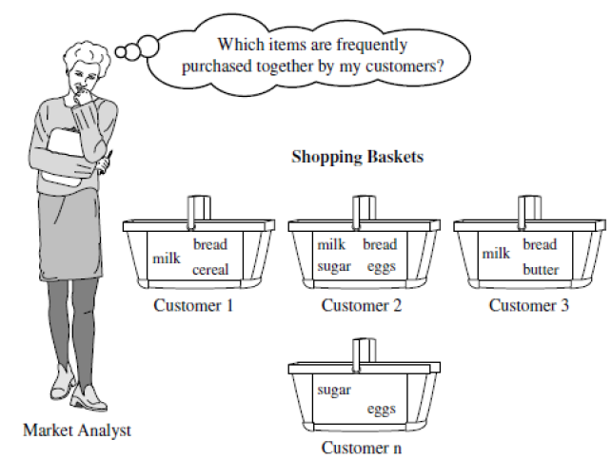
Market Basket Analysis: Frequent Pattern Mining
This process analyzes customer buying habits by finding associations between the different items that customers place in their shopping baskets.
The discovery of such associations can help retailers develop marketing strategies by gaining insight into which items are frequently purchased together by customers

Slide 43
Market Basket Analysis: Example
If customers who purchase computers also tend to buy antivirus-software at the same time, then placing the hardware display close to the software display may help increase the sales of both items. In an alternative strategy, placing hardware and software at opposite ends of the store may entice customers who purchase such items to pick up other items along the way. For instance, after deciding on an expensive computer, a customer may observe security systems for sale while heading toward the software display to purchase antivirus software and may decide to purchase a home security system as well. Market basket analysis can also help retailers plan which items to put on sale at reduced prices. If customers tend to purchase computers and printers together, then having a sale on printers may encourage the sale of printers as well as computers.

Slide 44
Frequent Pattern Mining
Frequent pattern mining can be classified in various ways, based on the following criteria:
Based on the completeness of patterns to be mined:
We can mine the complete set of frequent itemsets, the closed frequent itemsets, and the maximal frequent itemsets, given a minimum support threshold
We can also mine constrained frequent itemsets, approximate frequent itemsets, near-match frequent itemsets, top-k frequent itemsets and so on.

Slide 45
Frequent Pattern Mining
Based on the levels of abstraction involved in the rule set:
Some methods for association rule mining can find rules at differing levels of abstraction.
For example, suppose that a set of association rules mined includes the following rules where X is a variable representing a customer:
buys(X, “computer”) => buys(X, “HP printer”‖) .................. (1)
buys(X, “laptop computer”) => buys(X, “HP printer”) ............(2)
In rule (1) and (2), the items bought are referenced at different levels of abstraction (e.g., “computer” is a higher-level abstraction of “laptop computer”).

Slide 46
Frequent Pattern Mining
Based on the number of data dimensions involved in the rule:
If the items or attributes in an association rule reference only one dimension, then it is a single-dimensional association rule.
buys(X, “computer”) => buys(X, “antivirus software”)
If a rule references two or more dimensions, such as the dimensions age, income, and buys, then it is a multidimensional association rule. The following rule is an example of a multidimensional rule:
age(X, “30,31…39”‖) ^ income(X, “42K,…48K”) => buys(X, “high resolution TV”)

Slide 47
Frequent Pattern Mining
Based on the types of values handled in the rule:
If a rule involves associations between the presence or absence of items, it is a Boolean association rule.
If a rule describes associations between quantitative items or attributes, then it is a quantitative association rule.
Based on the kinds of rules to be mined:
Frequent pattern analysis can generate various kinds of rules and other interesting relationships.
Association rule mining can generate a large number of rules, many of which are redundant or do not indicate a correlation relationship among itemsets.
The discovered associations can be further analyzed to uncover statistical correlations, leading to correlation rules.

Slide 48
Frequent Pattern Mining
Based on the kinds of patterns to be mined:
Many kinds of frequent patterns can be mined from different kinds of data sets.
Sequential pattern mining searches for frequent sub-sequences in a sequence data set, where a sequence records an ordering of events.
For example, with sequential pattern mining, we can study the order in which items are frequently purchased. For instance, customers may tend to first buy a PC, followed by a digital camera and then a memory card.
Structured pattern mining searches for frequent sub-structures in a structured data set.
Single items are the simplest form of structure.
Each element of an itemset may contain a subsequence, a sub-tree, and so on.
Therefore, structured pattern mining can be considered as the most general form of frequent pattern mining.

Slide 49
From Association Mining to Correlation Analysis:
A correlation measure can be used to augment the support-confidence framework for association rules.
This leads to correlation rules of the form
A=>B [support, confidence, correlation]
That is, a correlation rule is measured not only by its support and confidence but also by the correlation between itemsets A and B.
There are many different correlation measures from which to choose.
We explore various correlation measures to determine which would be good for mining large data sets.

Slide 50


From Association Mining to Correlation Analysis:
Lift is a simple correlation measure that is given as follows:
The occurrence of itemset A is independent of the occurrence of itemset B if ; otherwise, itemsets A and B are dependent and correlated as events
This definition can easily be extended to more than two itemsets.
The lift between the occurrence of A and B can be measured by computing

Slide 51
From Association Mining to Correlation Analysis:
If the lift(A,B) is less than 1, then the occurrence of A is negatively correlated with the occurrence of B.
If the resulting value is greater than 1, then A and B are positively correlated, meaning that the occurrence of one implies the occurrence of the other.
If the resulting value is equal to 1, then A and B are independent and there is no correlation between them.

Slide 52
Classification and Prediction:
Classification and prediction are two forms of data analysis that can be used to extract models describing important data classes or to predict future data trends.
Classification predicts categorical (discrete, unordered) labels, prediction models continuous valued functions.
For example, we can build a classification model to categorize bank-loan applications as either safe or risky, or a prediction model to predict the expenditures of potential customers on computer equipment given their income and occupation.
A predictor is constructed that predicts a continuous-valued function, or ordered value, as opposed to a categorical label.
Regression analysis is a statistical methodology that is most often used for numeric prediction.

Slide 53
Classification and Prediction:
Many classification and prediction methods have been proposed by researchers in machine learning, pattern recognition, and statistics.
Most algorithms are memory resident, typically assuming a small data size.
Recent data mining research has built on such work, developing scalable classification and prediction techniques capable of handling large disk-resident data.

Slide 54
Issues Regarding Classification and Prediction:
Preparing the Data for Classification and Prediction:
The following pre-processing steps may be applied to the data to help improve the accuracy, efficiency, and scalability of the classification or prediction process.
(i) Data cleaning:
This refers to the pre-processing of data in order to remove or reduce noise (by applying smoothing techniques) and the treatment of missing values (e.g., by replacing a missing value with the most commonly occurring value for that attribute, or with the most probable value based on statistics).
Although most classification algorithms have some mechanisms for handling noisy or missing data, this step can help reduce confusion during learning.

Slide 55
Issues Regarding Classification and Prediction:
(ii) Relevance analysis:
Many of the attributes in the data may be redundant.
Correlation analysis can be used to identify whether any two given attributes are statistically related.
For example, a strong correlation between attributes A1 and A2 would suggest that one of the two could be removed from further analysis.
A database may also contain irrelevant attributes.
Attribute subset selection can be used in these cases to find a reduced set of attributes such that the resulting probability distribution of the data classes is as close as possible to the original distribution obtained using all attributes.
Hence, relevance analysis, in the form of correlation analysis and attribute subset selection, can be used to detect attributes that do not contribute to the classification or prediction task.
Such analysis can help improve classification efficiency and scalability.

Slide 56
Issues Regarding Classification and Prediction:
(iii) Data Transformation and Reduction
The data may be transformed by normalization, particularly when neural networks or methods involving distance measurements are used in the learning step.
Normalization involves scaling all values for a given attribute so that they fall within a small specified range, such as -1 to +1 or 0 to 1.
The data can also be transformed by generalizing it to higher-level concepts. Concept hierarchies may be used for this purpose.
This is particularly useful for continuous valued attributes.
For example, numeric values for the attribute income can be generalized to discrete ranges, such as low, medium, and high. Similarly, categorical attributes, like street, can be generalized to higher-level concepts, like city.
Data can also be reduced by applying many other methods, ranging from wavelet transformation and principle components analysis to discretization techniques, such as binning, histogram analysis, and clustering.

Slide 57
Comparing Classification and Prediction Methods:
Accuracy:
The accuracy of a classifier refers to the ability of a given classifier to correctly predict the class label of new or previously unseen data (i.e., tuples without class label information).
The accuracy of a predictor refers to how well a given predictor can guess the value of the predicted attribute for new or previously unseen data.
Speed:
This refers to the computational costs involved in generating and using the given classifier or predictor.
Robustness:
This is the ability of the classifier or predictor to make correct predictions given noisy data or data with missing values

Slide 58
Comparing Classification and Prediction Methods:
Scalability:
This refers to the ability to construct the classifier or predictor efficiently given large amounts of data.
Interpretability:
This refers to the level of understanding and insight that is provided by the classifier or predictor.
Interpretability is subjective and therefore more difficult to assess.

Slide 59
Classification by Decision Tree Induction:
Decision tree induction is the learning of decision trees from class-labeled training tuples.
A decision tree is a flowchart-like tree structure, where
Each internal node denotes a test on an attribute.
Each branch represents an outcome of the test.
Each leaf node holds a class label.
The topmost node in a tree is the root node.

Slide 60
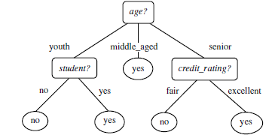
Classification by Decision Tree Induction:

Slide 61
Classification by Decision Tree Induction:
The construction of decision tree classifiers does not require any domain knowledge or parameter setting, and therefore is appropriate for exploratory knowledge discovery.
Decision trees can handle high dimensional data.
The representation of acquired knowledge in tree form is intuitive and generally easy to assimilate by humans.
The learning and classification steps of decision tree induction are simple and fast.
In general, decision tree classifiers have good accuracy.
Decision tree induction algorithms have been used for classification in many application areas, such as medicine, manufacturing and production, financial analysis, astronomy, and molecular biology.

Slide 62
Bayesian Classification:
Bayesian classifiers are statistical classifiers.
They can predict class membership probabilities, such as the probability that a given tuple belongs to a particular class.
Bayesian classification is based on Bayes’ theorem.
Bayes’ Theorem:
Let X be a data tuple. In Bayesian terms, X is considered “evidence", and it is described by measurements made on a set of n attributes.
Let H be some hypothesis, such as that the data tuple X belongs to a specified class C.

Slide 63

Bayesian Classification:
For classification problems, we want to determine P(H|X), the probability that the hypothesis H holds given the “evidence”‖ or observed data tuple X.
P(H|X) is the posterior probability, or a posteriori probability, of H conditioned on X.
Bayes’ theorem is useful in that it provides a way of calculating the posterior probability, P(H|X), from P(H), P(X|H), and P(X).

Slide 64
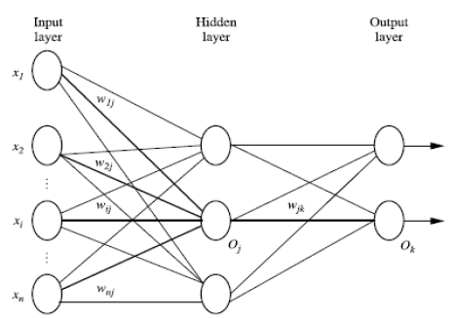
A Multilayer Feed-Forward Neural Network:
The back-propagation algorithm performs learning on a multilayer feed-forward neural network.
It iteratively learns a set of weights for prediction of the class label of tuples.
A multilayer feed-forward neural network consists of an input layer, one or more hidden layers, and an output layer.

Slide 65
A Multilayer Feed-Forward Neural Network:
The inputs to the network correspond to the attributes measured for each training tuple.
The inputs are fed simultaneously into the units making up the input layer.
These inputs pass through the input layer and are then weighted and fed simultaneously to a second layer known as a hidden layer.
The outputs of the hidden layer units can be input to another hidden layer, and so on.
The number of hidden layers is arbitrary.
The weighted outputs of the last hidden layer are input to units making up the output layer, which emits the network’s prediction for given tuples
Well-suited for continuous-valued inputs and outputs, unlike most decision tree algorithms.
Have been successful on a wide array of real-world data, including handwritten character recognition, pathology and laboratory medicine, and training a computer to pronounce English text.

Slide 66
k-Nearest-Neighbor Classifier:
K-Nearest-neighbor classifiers are based on learning by analogy, that is, by comparing a given test tuple with training tuples that are similar to it.
The training tuples are described by n attributes.
Each tuple represents a point in an n-dimensional space.
In this way, all of the training tuples are stored in an n-dimensional pattern space.
When given an unknown tuple, a k-nearest-neighbor classifier searches the pattern space for the k training tuples that are closest to the unknown tuple.
These k training tuples are the k nearest neighbors of the unknown tuple.
Closeness is defined in terms of a distance metric, such as Euclidean distance.

Slide 67

k-Nearest-Neighbor Classifier:
The Euclidean distance between two points or tuples, say, X1 = (x11, x12, … , x1n) and X2 = (x21, x22, … ,x2n),
For k-nearest-neighbor classification, the unknown tuple is assigned the most common class among its k nearest neighbors.
When k = 1, the unknown tuple is assigned the class of the training tuple that is closest to it in pattern space.
Nearest neighbor classifiers can also be used for prediction, that is, to return a real-valued prediction for a given unknown tuple.
In this case, the classifier returns the average value of the real-valued labels associated with the k nearest neighbors of the unknown tuple.

Slide 68
Regression Analysis:
Regression analysis can be used to model the relationship between one or more independent or predictor variables and a dependent or response variable which is continuous-valued.
In the context of data mining, the predictor variables are the attributes of interest describing the tuple (i.e., making up the attribute vector).
In general, the values of the predictor variables are known.
The response variable is what we want to predict.

Slide 69
Linear Regression:
Straight-line regression analysis involves a response variable, y, and a single predictor variable x.
It is the simplest form of regression, and models y as a linear function of x.
That is, y = b + wx where the variance of y is assumed to be constant b and w are regression coefficients specifying the Y-intercept and slope of the line.
The regression coefficients, w and b, can also be thought of as weights, so that we can equivalently write, y = w₀ + w₁x
These coefficients can be solved for by the method of least squares, which estimates the best-fitting straight line as the one that minimizes the error between the actual data and the estimate of the line.

Slide 70
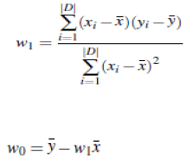
Linear Regression:
Let D be a training set consisting of values of predictor variable, x, for some population and their associated values for response variable, y. The training set contains |D| data points of the form: (x1, y1), (x2, y2), … , (x|D|, y|D|).
The regression coefficients can be estimated using this method with the following equations:
where x is the mean value of x1, x2, … , x|D|, and y is the mean value of y1, y2,…, y|D|. The coefficients w₀ and w₁ often provide good approximations to otherwise complicated regression equations.

Slide 71
Classifier Accuracy:
The accuracy of a classifier on a given test set is the percentage of test set tuples that are correctly classified by the classifier.
In the pattern recognition literature, this is also referred to as the overall recognition rate of the classifier, that is, it reflects how well the classifier recognizes tuples of the various classes.
The error rate or misclassification rate of a classifier, M, which is simply 1-Acc(M), where Acc(M) is the accuracy of M.
The confusion matrix is a useful tool for analyzing how well your classifier can recognize tuples of different classes.
True positives refer to the positive tuples that were correctly labeled by the classifier.
True negatives are the negative tuples that were correctly labeled by the classifier.
False positives are the negative tuples that were incorrectly labeled.

Slide 72
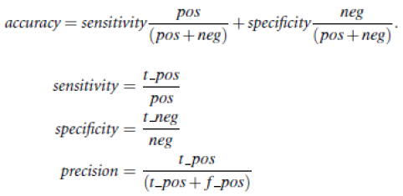
Classifier Accuracy:
How well the classifier can recognize, for this sensitivity and specificity measures can be used.
Accuracy is a function of sensitivity and specificity.
Where t_posis the number of true positives; pos is the number of positive tuples t_negis the number of true negatives neg is the number of negative tuples, f_pos is the number of false positives

Slide 73
Cluster Analysis:
The process of grouping a set of physical or abstract objects into classes of similar objects is called clustering.
A cluster is a collection of data objects that are similar to one another within the same cluster and are dissimilar to the objects in other clusters.
A cluster of data objects can be treated collectively as one group and so may be considered as a form of data compression.
Cluster analysis tools based on k-means, k-medoids, and several methods have also been built into many statistical analysis software packages or systems, such as S-Plus, SPSS, and SAS.

Slide 74
Cluster Analysis: Applications
Cluster analysis has been widely used in numerous applications, including market research, pattern recognition, data analysis, and image processing.
In business, clustering can help marketers discover distinct groups in their customer bases and characterize customer groups based on purchasing patterns.
In biology, it can be used to derive plant and animal taxonomies, categorize genes with similar functionality, and gain insight into structures inherent in populations.
Helps in the identification of areas of similar land use in an earth observation database and in the identification of groups of houses in a city according to house type, value, and geographic location, as well as the identification of groups of automobile insurance policy holders with a high average claim cost.
Clustering is also called data segmentation in some applications because clustering partitions large data sets into groups according to their similarity.
Clustering can also be used for outlier detection. Applications of outlier detection include the detection of credit card fraud and the monitoring of criminal activities in electronic commerce.

Slide 75
Typical Requirements Of Clustering In Data Mining:
Scalability:
Many clustering algorithms work well on small data sets containing fewer than several hundred data objects; however, a large database may contain millions of objects.
Clustering on a sample of a given large data set may lead to biased results.
Highly scalable clustering algorithms are needed.
Ability to deal with different types of attributes:
Many algorithms are designed to cluster interval-based (numerical) data.
However, applications may require clustering other types of data, such as binary, categorical (nominal) , ordinal data, or mixtures of these data types.

Slide 76
Typical Requirements Of Clustering In Data Mining:
Discovery of clusters with arbitrary shape:
Many clustering algorithms determine clusters based on Euclidean or Manhattan distance measures.
Algorithms based on such distance measures tend to find spherical clusters with similar size and density.
However, a cluster could be of any shape. It is important to develop algorithms that can detect clusters of arbitrary shape.
Minimal requirements for domain knowledge to determine input parameters:
Many clustering algorithms require users to input certain parameters in cluster analysis (such as the number of desired clusters).
The clustering results can be quite sensitive to input parameters. Parameters are often difficult to determine, especially for data sets containing high-dimensional objects.
This not only burdens users, but it also makes the quality of clustering difficult to control.

Slide 77
Typical Requirements Of Clustering In Data Mining:
Ability to deal with noisy data:
Most real-world databases contain outliers or missing, unknown, or erroneous data.
Some clustering algorithms are sensitive to such data and may lead to clusters of poor quality.
Incremental clustering and insensitivity to the order of input records:
Some clustering algorithms cannot incorporate newly inserted data (i.e., database updates) into existing clustering structures and, instead, must determine a new clustering from scratch.
Some clustering algorithms are sensitive to the order of input data.
That is, given a set of data objects, such an algorithm may return dramatically different clusterings depending on the order of presentation of the input objects.
It is important to develop incremental clustering algorithms and algorithms that are insensitive to the order of input.

Slide 78
Typical Requirements Of Clustering In Data Mining:
High dimensionality:
A database or a data warehouse can contain several dimensions or attributes.
Many clustering algorithms are good at handling low-dimensional data, involving only two to three dimensions.
Human eyes are good at judging the quality of clustering for up to three dimensions.
Finding clusters of data objects in high-dimensional space is challenging, especially considering that such data can be sparse and highly skewed.
Constraint-based clustering:
Real-world applications may need to perform clustering under various kinds of constraints.
Suppose that your job is to choose the locations for a given number of new automatic banking machines (ATMs) in a city.

Slide 79
Typical Requirements Of Clustering In Data Mining:
To decide upon this, you may cluster households while considering constraints such as the city’s rivers and highway networks, and the type and number of customers per cluster.
A challenging task is to find groups of data with good clustering behavior that satisfy specified constraints
Interpretability and usability:
Users expect clustering results to be interpretable, comprehensible, and usable.
That is, clustering may need to be tied to specific semantic interpretations and applications.
It is important to study how an application goal may influence the selection of clustering features and methods.

Slide 80
Major Clustering Methods:
Partitioning Methods
Hierarchical Methods
Density-Based Methods
Grid-Based Methods
Model-Based Methods

Slide 81
Partitioning Methods
A partitioning method constructs k partitions of the data, where each partition represents a cluster and k <= n.
That is, it classifies the data into k groups, which together satisfy the following requirements:
Each group must contain at least one object, and
Each object must belong to exactly one group.
A partitioning method creates an initial partitioning. It then uses an iterative relocation technique that attempts to improve the partitioning by moving objects from one group to another.
The general criterion of a good partitioning is that objects in the same cluster are close or related to each other, whereas objects of different clusters are far apart or very different

Slide 82
Hierarchical Methods
A hierarchical method creates a hierarchical decomposition of the given set of data objects.
A hierarchical method can be classified as being either agglomerative or divisive, based on how the hierarchical decomposition is formed.
The agglomerative approach, also called the bottom-up approach, starts with each object forming a separate group. It successively merges the objects or groups that are close to one another, until all of the groups are merged into one or until a termination condition holds.
The divisive approach, also called the top-down approach, starts with all of the objects in the same cluster. In each successive iteration, a cluster is split up into smaller clusters, until eventually each object is in one cluster, or until a termination condition holds.
Hierarchical methods suffer from the fact that once a step (merge or split) is done, it can never be undone. This rigidity is useful in that it leads to smaller computation costs by not having to worry about a combinatorial number of different choices. Remedy by:
Performing careful analysis of object “linkages” at each hierarchical partitioning, such as in Chameleon, or integrate hierarchical agglomeration and other approaches by first using a hierarchical agglomerative algorithm to group objects into micro-clusters, and then performing macro-clustering on the micro-clusters using another clustering method such as iterative relocation.

Slide 83
Density-based methods:
Most partitioning methods cluster objects based on the distance between objects.
Such methods can find only spherical-shaped clusters and encounter difficulty at discovering clusters of arbitrary shapes.
Other clustering methods have been developed based on the notion of density.
Their general idea is to continue growing the given cluster as long as the density in the neighborhood exceeds some threshold; that is, for each data point within a given cluster, the neighborhood of a given radius has to contain at least a minimum number of points.
Such a method can be used to filter out noise (outliers)and discover clusters of arbitrary shape.
DBSCAN and its extension, OPTICS, are typical density-based methods that grow clusters according to a density-based connectivity analysis.
DENCLUE is a method that clusters objects based on the analysis of the value distributions of density functions.

Slide 84
Grid-Based Methods:
Grid-based methods quantize the object space into a finite number of cells that form a grid structure.
All of the clustering operations are performed on the grid structure i.e., on the quantized space.
The main advantage of this approach is its fast processing time, which is typically independent of the number of data objects and dependent only on the number of cells in each dimension in the quantized space.
STING is a typical example of a grid-based method.
Wave Cluster applies wavelet transformation for clustering analysis and is both grid-based and density-based.

Slide 85
Model-Based Methods:
Model-based methods hypothesize a model for each of the clusters and find the best fit of the data to the given model.
A model-based algorithm may locate clusters by constructing a density function that reflects the spatial distribution of the data points.
It also leads to a way of automatically determining the number of clusters based on standard statistics, taking “noise”‖ or outliers into account and thus yielding robust clustering methods.

Slide 86
Clustering High-Dimensional Data:
It is a particularly important task in cluster analysis because many applications require the analysis of objects containing a large number of features or dimensions.
For example, text documents may contain thousands of terms or keywords as features, and DNA micro array data may provide information on the expression levels of thousands of genes under hundreds of conditions.
Clustering high-dimensional data is challenging due to the curse of dimensionality.
Many dimensions may not be relevant. As the number of dimensions increases, the data become increasingly sparse so that the distance measurement between pairs of points become meaningless and the average density of points anywhere in the data is likely to be low.
Therefore, a different clustering methodology needs to be developed for high-dimensional data.

Slide 87
Clustering High-Dimensional Data:
CLIQUE and PROCLUS are two influential subspace clustering methods, which search for clusters in subspaces of the data, rather than over the entire data space.
Frequent pattern–based clustering is another clustering methodology, that extracts distinct frequent patterns among subsets of dimensions that occur frequently.
It uses such patterns to group objects and generate meaningful clusters.

Slide 88
Constraint-Based Clustering:
It is a clustering approach that performs clustering by incorporation of user-specified or application-oriented constraints.
A constraint expresses a user’s expectation or describes properties of the desired clustering results, and provides an effective means for communicating with the clustering process.
Various kinds of constraints can be specified, either by a user or as per application requirements.
Spatial clustering employs with the existence of obstacles and clustering under user-specified constraints.
In addition, semi-supervised clustering employs for pairwise constraints in order to improve the quality of the resulting clustering.

Slide 89
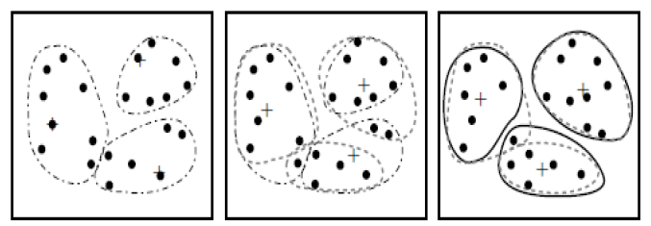
The K-Means Method
The k-means algorithm is a centroid-based Technique
It takes the input parameter, k, and partitions a set of n objects into k clusters so that the resulting intra-cluster similarity is high but the inter-cluster similarity is low.
Cluster similarity is measured in regard to the mean value of the objects in a cluster, which can be viewed as the cluster’s centroid or center of gravity.
The k-means algorithm proceeds as follows.

Slide 90

The K-Means Method
First, it randomly selects k of the objects, each of which initially represents a cluster mean or center.
For each of the remaining objects, an object is assigned to the cluster to which it is the most similar, based on the distance between the object and the cluster mean.
It then computes the new mean for each cluster.
This process iterates until the criterion function converges.
Typically, the square-error criterion is used, defined as
Where E is the sum of the square error for all objects in the data set p is the point in space representing a given object m_{i} is the mean of cluster C_{i}

Slide 91
Outlier Analysis:
There exist data objects that do not comply with the general behavior or model of the data.
Such data objects, which are grossly different from or inconsistent with the remaining set of data, are called outliers.
Many data mining algorithms try to minimize the influence of outliers or eliminate them all together.
This, however, could result in the loss of important hidden information because one person’s noise could be another person’s signal.
In other words, the outliers may be of particular interest, such as in the case of fraud detection, where outliers may indicate fraudulent activity.
Thus, outlier detection and analysis is an interesting data mining task, referred to as outlier mining.

Slide 92
Outlier Analysis:
It can be used in fraud detection, for example, by detecting unusual usage of credit cards or telecommunication services.
In addition, it is useful in customized marketing for identifying the spending behavior of customers with extremely low or extremely high incomes, or in medical analysis for finding unusual responses to various medical treatments.
Outlier mining can be described as follows:
Given a set of n data points or objects and k, the expected number of outliers, find the top k objects that are considerably dissimilar, exceptional, or inconsistent with respect to the remaining data.
The outlier mining problem can be viewed as two subproblems:
Define what data can be considered as inconsistent in a given data set, and
Find an efficient method to mine the outliers so defined.

Slide 93
Types of outlier detection
Statistical Distribution-Based Outlier Detection
Distance-Based Outlier Detection
Density-Based Local Outlier Detection
Deviation-Based Outlier Detection

Slide 94
Major Issues in Data Mining
1. Mining methodology and user interaction issues
Mining different kinds of knowledge in databases
Interactive mining of knowledge at multiple levels of abstraction
Incorporation of background knowledge
Data mining query languages and ad-hoc data mining
Expression and visualization of data mining results
Handling noise and incomplete data
Pattern evaluation: the interestingness problem

Slide 95
Major Issues in Data Mining
2. Performance issues
Efficiency and scalability of data mining algorithms
Parallel, distributed and incremental mining methods

Slide 96
Major Issues in Data Mining
3. Issues relating to the diversity of data types
Handling relational(simple) and complex types of data.
Mining information from heterogeneous databases and global information systems (WWW)

Slide 97
Data Mining and Business Intelligence
Increasing potential
to support
business decisions
Making
Decisions
End User
Data Presentation
Business
Analyst
Visualization Techniques
Data Mining
Data
Analyst
Information Discovery
Data Exploration
Statistical Analysis, Querying and Reporting
Data Warehouses / Data Marts
OLAP, MDA
DBA
Data Sources
Paper, Files, Information Providers, Database Systems, OLTP

